Slide 1




Day Planner
Tech Renegades
19 September 2023

Slide 2







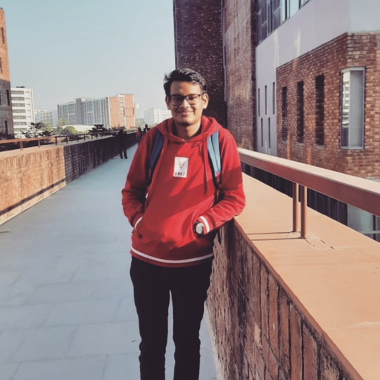



Meet our Team
Pragya
Anchal
Sophia Singh
Murtaza
Arnav
Sahil

Slide 3


Today's
Agenda
What’s our project
Key Features

Slide 4


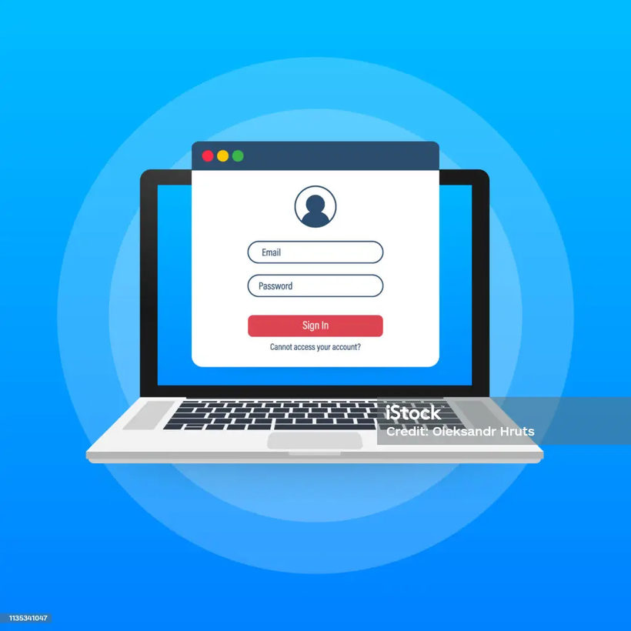

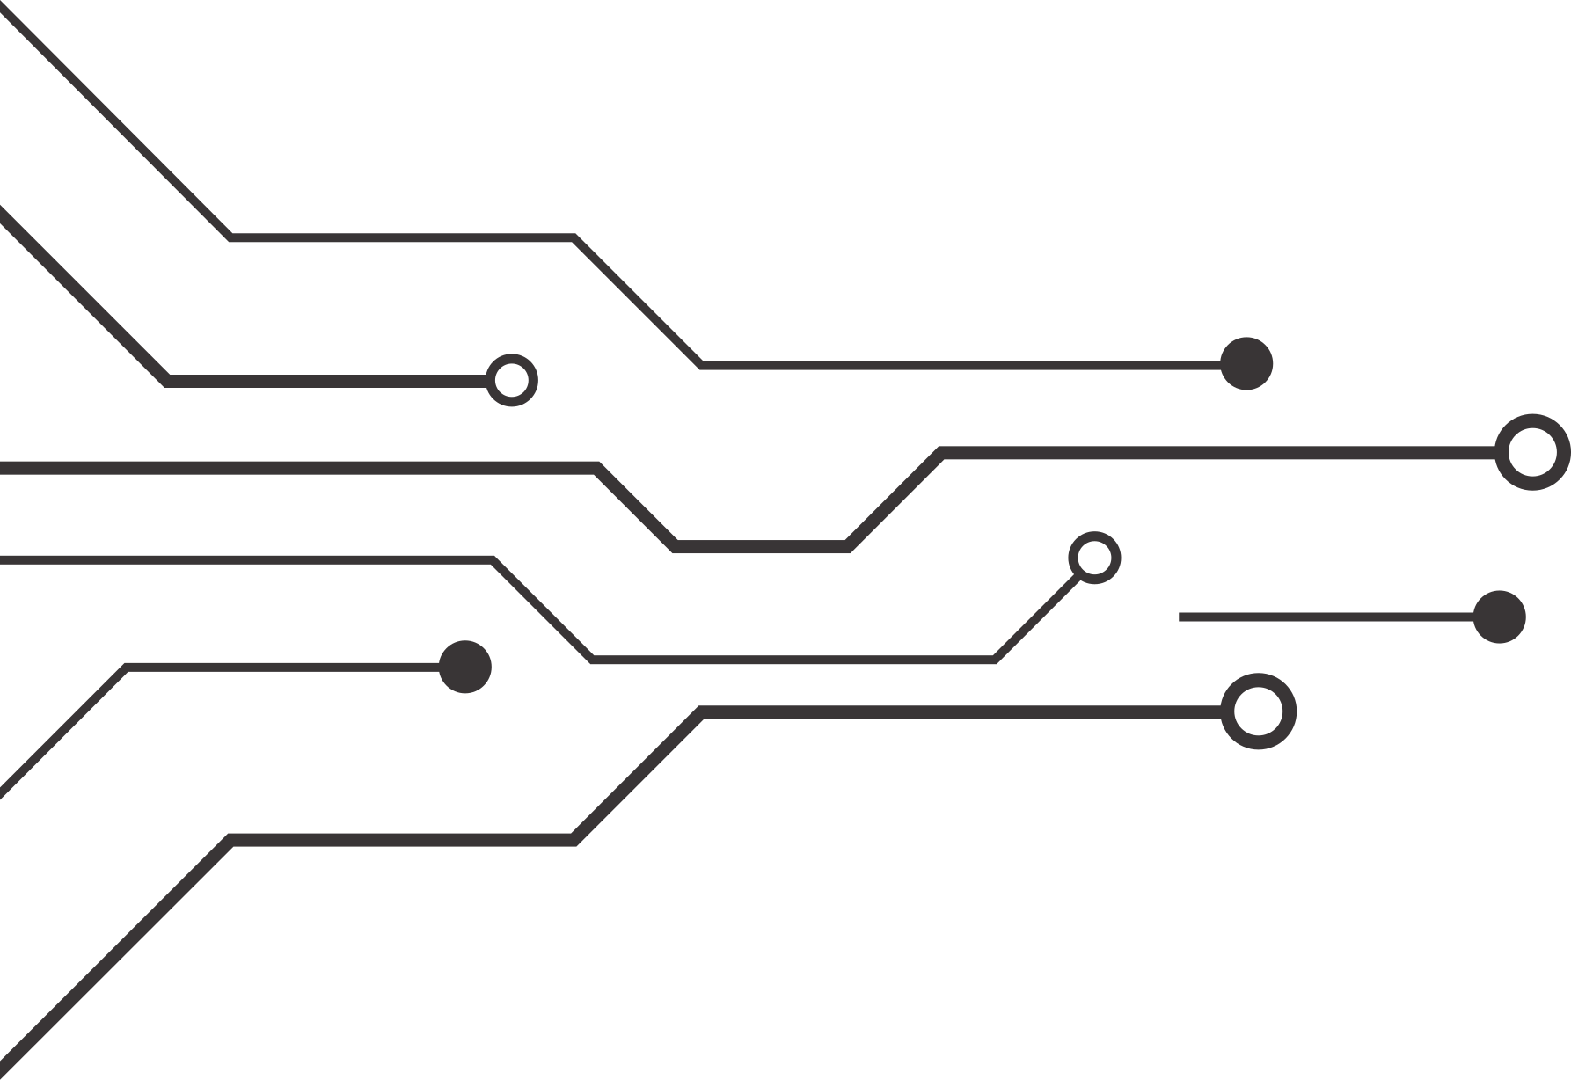

Login Based
Enhancing User authentication and integrity with Two-Factor Authentication and Task Management
A comprehensive approach to Secure Login and Efficient Task Completion

Slide 5



Access
Enhancing User data confidentiality and data protection.
Control accessibility based on task categories
Intrusion Detection
Security
Login
User Authentication using Password policies and Multi-Factor Authentication.
Ensuring secure access to the app
A vital security measure in today's digital landscape
Data
Stealth Mode to hide user’s sensitive data
Enhanced security and data segregation
Data backup and recovery

Slide 6

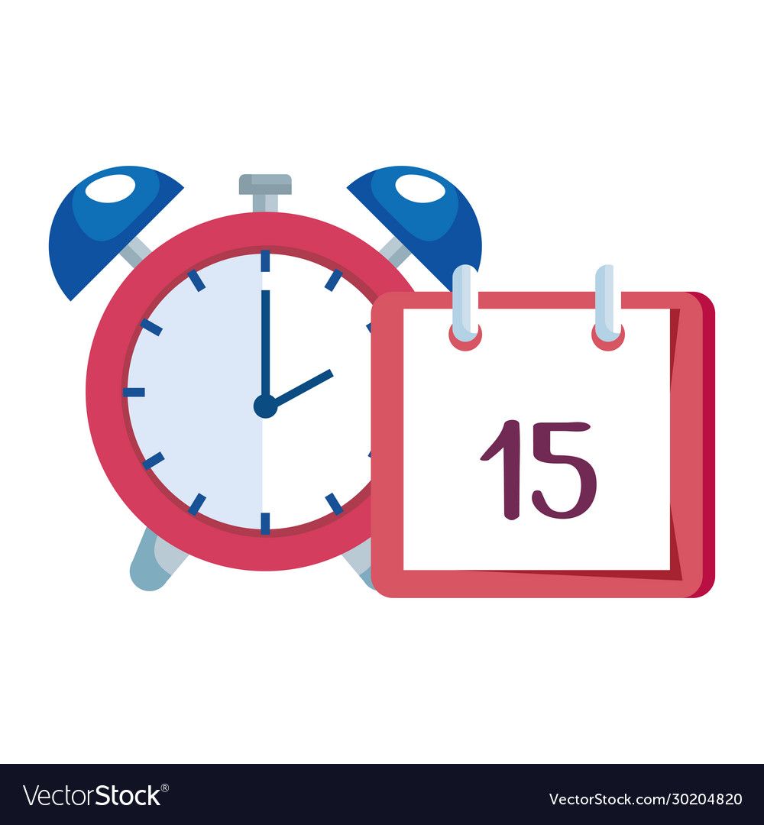
Categories
Notifications and Reminders
Set predefined categories for tasks
Give access to users to add more categories
Improved task management and efficiency
Collaborations
Customize Reminders
Notification for priority tasks even on DND
Ensure important tasks are not missed
Customized reminders for time-sensitive tasks
Adjust reminders to remind before a certain amount of time
E-mail and system reminders

Slide 7


Rewards
Reward system for timely task completion
Encourages punctuality and productivity
Incentivize users to meet deadlines
Motivate users to maintain a time-oriented approach

Slide 8


Recurrence and Realistic Simulations
Recurring tasks for routine activities
Streamline repetitive actions
Realistic simulation for example- morning walk
Engaging visualizations and interactive experiences

Slide 9





Priority Deadline and Task Completion
Set priorities according to task time
Ensure important tasks receive appropriate attention
Mark tasks as complete before time for bonus
Motivate users to complete tasks ahead of schedule
Ask for the feedback of the user after a certain duration of time

Slide 10





Focus mode during important tasks as per requirement
Minimize distractions and interruptions
Calls and system features adjusted accordingly
Optimized productivity and time management
Focus Mode and Office Hours

Slide 11
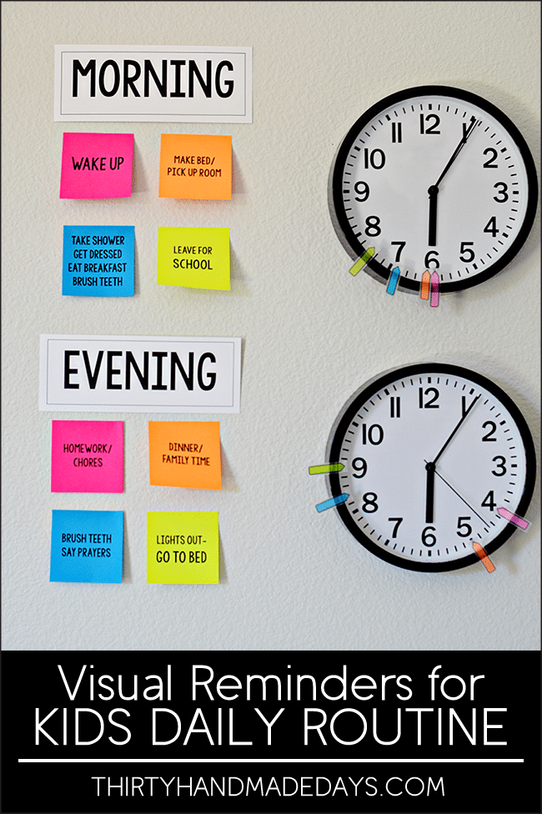
Daily Routine Suggestions and Reminders
Daily routine suggestions and Reminders
Assist in establishing effective daily routines
Medication Reminders for improved health
Reminder for appointments with doctor

Slide 12


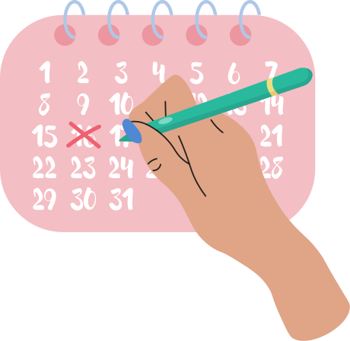
Task Completion Status on Calendar
Green block on the calendar for completed tasks
Visual indication of task completion
Red block for pending or incomplete tasks
Intuitive and clear task progress visualization

Slide 13


Dark mode and light mode for visual preferences
Enhanced readability and reduced eye strain
Notes section for task description
Ability to attach images and other documents with tasks
Some other features

Slide 14

THE BEGINNING

